Slide 1
Deep Learning
Week 6

Slide 2
Training Basics
The most basic method of training a neural network is trial and error.
If the network isn't behaving the way it should, change the weighting
of a random link by a random amount. If the accuracy of the network
declines, undo the change and make a different one.
It takes time, but the trial and error method does produce results.
Sample labeled data
(batch)
Forward it through the network, get predictions
Back-propagate the errors
Update the network weights

Slide 3
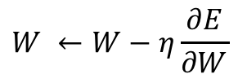
Training Basics
Searches for weight values that minimize the total error of the network over the set of training examples (training set).
Process:
Forward pass: in this step the network is activated on one example and the error of (each neuron of) the output layer is computed.
Backward pass: in this step the network error is used for updating the weights. Starting at the output layer, the error is propagated backwards through the network, layer by layer. This is done by recursively computing the local gradient of each neuron.
Network activation
Forward Step
$$W ←W−η\frac{∂E}{∂W}$$
Error propagation
Backward Step

Slide 4
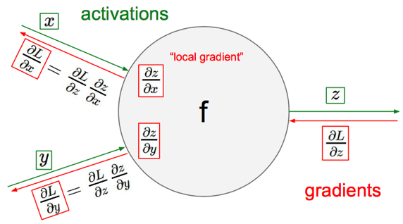
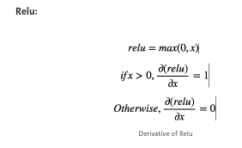
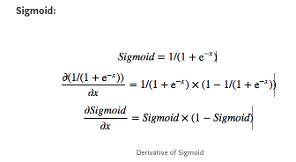
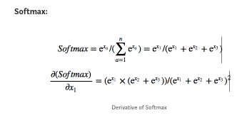
Chain rule-gradient descent

Slide 5
Forward Propagation

Slide 6
Forward Propagation

Slide 7
Backward Propagation
Similarly, we can calculate the other weight values as well.
After that we will again propagate forward and calculate the output. Again, we will calculate the error.

Slide 8
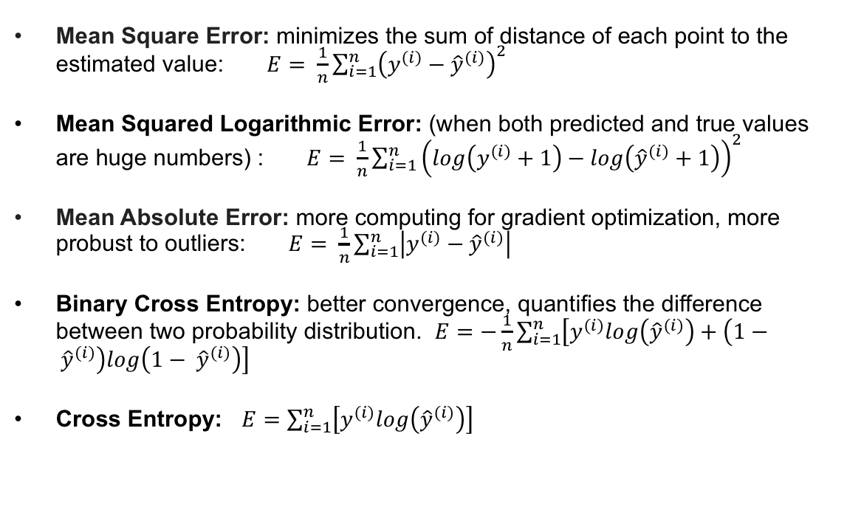
Loss function (energy function)
Mean Square Error: minimizes the sum of distance of each point to the estimated value: $E= \frac{1}{n}\sum_{i=1}^{n}{{\left(y^{(i)}−{\hat{y}}^{(i)}\right)}^{2}}$
Mean Squared Logarithmic Error: (when both predicted and true values are huge numbers) : $E= \frac{1}{n}\sum_{i=1}^{n}{{\left(log\left(y^{(i)}+1\right)−log\left({\hat{y}}^{(i)}+1\right)\right)}^{2}}$
Mean Absolute Error: more computing for gradient optimization, more probust to outliers: $E= \frac{1}{n}\sum_{i=1}^{n}{\left|y^{(i)}−{\hat{y}}^{(i)}\right|}$
Binary Cross Entropy: better convergence, quantifies the difference between two probability distribution. $E=−\frac{1}{n}\sum_{i=1}^{n}{\left[y^{(i)}log\left({\hat{y}}^{(i)}\right)+\left(1− {\hat{y}}^{(i)}\right)log\left(1− {\hat{y}}^{(i)}\right)\right]}$
Cross Entropy: $E=\sum_{i=1}^{n}{\left[y^{(i)}log\left({\hat{y}}^{(i)}\right)\right]}$

Slide 9
Regularization
Large neural nets trained on relatively small datasets can overfit the training data.
The common method for NN regularization are:
Randomly Drop Nodes
Add Random Noise During Training

Slide 10
Regularization-Dropout
Dropout is implemented per-layer in a neural network.
It can be used with most types of layers, such as dense fully connected layers, convolutional layers, and recurrent layers such as the long short-term memory network layer.
Dropout may be implemented on any or all hidden layers in the network as well as the visible or input layer. It is not used on the output layer.
The default interpretation of the dropout hyperparameter is the probability of training a given node in a layer, where 1.0 means no dropout, and 0.0 means no outputs from the layer.
A good value for dropout in a hidden layer is between 0.5 and 0.8. Input layers use a larger dropout rate, such as of 0.8.

Slide 11
Regularization-Noise
In effect, adding noise expands the size of the training dataset. Each time a training sample is exposed to the model, random noise is added to the input variables making them different every time it is exposed to the model. In this way, adding noise to input samples is a simple form of data augmentation.
The most common type of noise used during training is the addition of Gaussian noise to input variables.
The amount of noise added (e.g. the spread or standard deviation) is a configurable hyperparameter. Too little noise has no effect, whereas too much noise makes the mapping function too challenging to learn.

Slide 12
Regularization-Noise
Noise to the inputs is the most common and widely studied approach, However random noise can be added to other parts of the network during training.
Some examples include adding noise to :
Activations, i.e. the outputs of each layer.
Weights, i.e. an alternative to the inputs.
Gradients, i.e. the direction to update weights.
Outputs, i.e. the labels or target variables.
It is appropriate to try adding noise to both classification and regression type problems.
Noise is only added during the training of your model. Be sure that any source of noise is not added during the evaluation of your model, or when your model is used to make predictions on new data.

Slide 13
Why we need Normalization?
The ranges of the distributions of feature values might be different for each feature, and thus the learning rate would cause corrections in each dimension that would differ (proportionally speaking) from one another.
We might be over compensating a correction in one weight dimension while undercompensating in another.
Types of normalization:
Batch Normalization
Layer Normalization

Slide 14
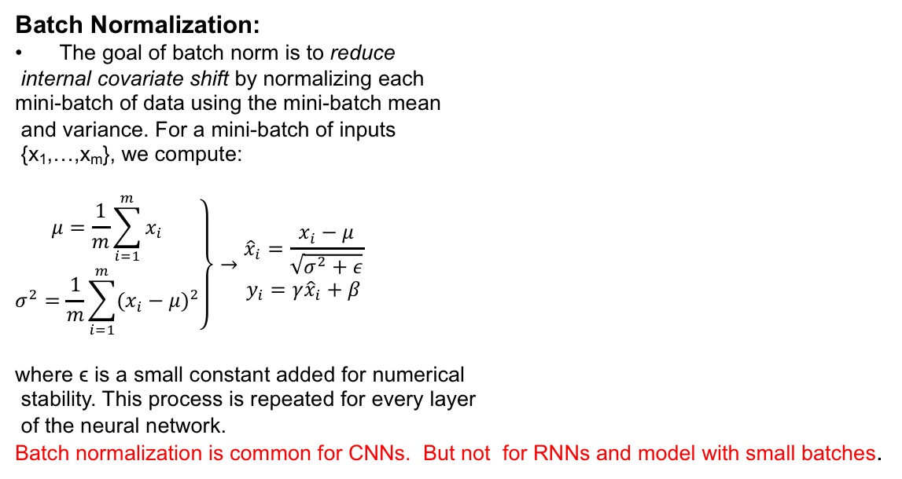
Normalization
Batch Normalization:
The goal of batch norm is to reduce
internal covariate shift by normalizing each
mini-batch of data using the mini-batch mean
and variance. For a mini-batch of inputs
{x₁,…,x_{m}}, we compute:
$$\left.\begin{matrix}μ=\frac{1}{m}\sum_{i=1}^{m}{x_{i}} \\ σ^{2}=\frac{1}{m}\sum_{i=1}^{m}{{(x_{i}−μ)}^{2}}\end{matrix}\right\}→\begin{matrix}{\hat{x}}_{i}=\frac{x_{i}−μ}{\sqrt{σ^{2}+ε}} \\ y_{i}=γ{\hat{x}}_{i}+β\end{matrix}$$
where ϵ is a small constant added for numerical
stability. This process is repeated for every layer
of the neural network.
Batch normalization is common for CNNs. But not for RNNs and model with small batches.

Slide 15
Batch Normalization in Keras
The original paper that introduced the method suggests adding batch normalization before the activation function of the previous layer.
model = Sequential
model.add(BatchNormalization())
model.add(Dense(32, activation='relu'))
Some experiment better performance when adding the batch normalization layer after the activation function of the previous layer.
model = Sequential
model.add(Dense(32, activation='relu'))
model.add(BatchNormalization())
If time and resources permit, it may be worth testing both approaches on your model and use the approach that results in the best performance.

Slide 16
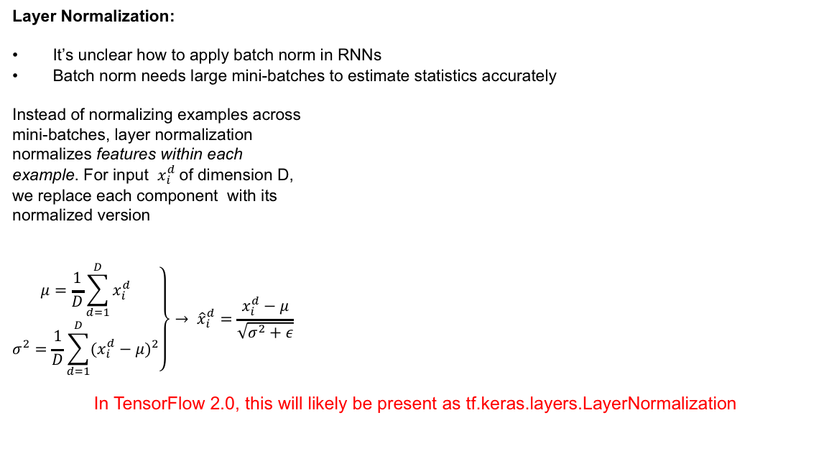
Normalization
Layer Normalization:
It’s unclear how to apply batch norm in RNNs
Batch norm needs large mini-batches to estimate statistics accurately
Instead of normalizing examples across
mini-batches, layer normalization
normalizes features within each
example. For input $x_{i}^{d}$of dimension D,
we replace each component with its
normalized version
$$\left.\begin{matrix}μ=\frac{1}{D}\sum_{d=1}^{D}{x_{i}^{d}} \\ σ^{2}=\frac{1}{D}\sum_{d=1}^{D}{{(x_{i}^{d}−μ)}^{2}}\end{matrix}\right\}→ {\hat{x}}_{i}^{d}=\frac{x_{i}^{d}−μ}{\sqrt{σ^{2}+ε}}$$
In TensorFlow 2.0, this will likely be present as tf.keras.layers.LayerNormalization

Slide 17
Vanishing gradient
moving backward in the Network and calculating gradients of loss(Error) with respect to the weights , the gradients tends to get smaller and smaller as we keep on moving backward in the Network. This means that the neurons in the Earlier layers learn very slowly as compared to the neurons in the later layers in the Hierarchy.
Solution:
Do not use Sigmoid and Tanh as Activation functions which causes vanishing Gradient Problems .
Weight initialization schemes.

Slide 18
Exploding gradient
The exploding gradients problem refers to the large increase in the norm of the gradient during training.
There are some less subtle signs to confirm have exploding gradients.
The model weights quickly become very large during training.
The model weights go to NaN values during training.
The error gradient values are consistently above 1.0 for each node and layer during training.

Slide 19
Exploding Solution
Solution:
Redesigning the network to have fewer layers.
There may also be some benefit in using a smaller batch size while training the network
Use Long Short-Term Memory Networks.
Use Gradient Clipping.
Use Weight Regularization (L₁ (absolute weights) or an L₂ (squared weights)

Slide 20
Tensor Flow
Originally developed by Google Brain Team to conduct machine learning and deep neural networks research
Open source software library for numerical computation using data flow graphs
Applicable in a wide variety of other machine learning domains
Allow users to build various models from scratch.
Flexibility; from Raspberry Pi, Android, Windows, iOS, Linux to server farms
Visualization (via TensorBoard)

Slide 21



























Tensor Flow
More: https://outsourceit.today/companies-using-TensorFlow/

Slide 22
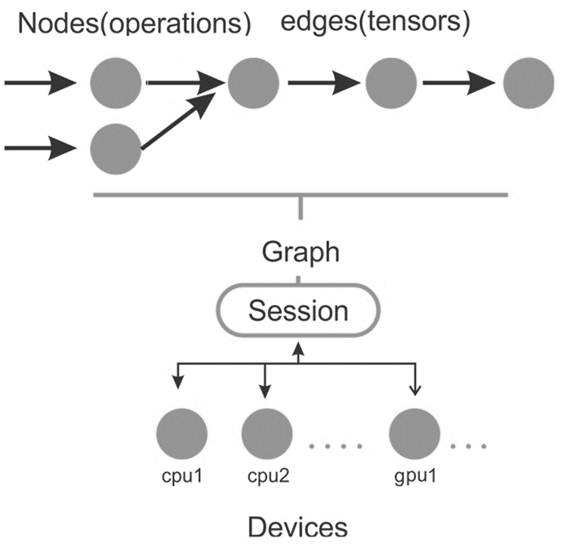
TensorFlow in a nutshell
Construct computational graph:
A set of nodes, each one
representing an operation
A set of directed arcs, each
one representing the data on
which the operations are performed.
Create a session
Active session to be executed by
multiple CPUs

Slide 23
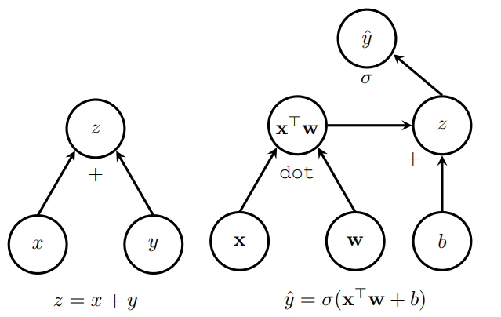
TensorFlow Graph
A computational or dataflow graph is a form of directed graph where vertices or nodes describe operations, while edges represent data flowing between these operations.
The graph is a set of computation that takes place successively.

Slide 24
Fetches
To fetch the outputs of operations, execute the graph by calling run() on the session object and pass in the tensors to retrieve.
Except fetching the single tensor node, you can also fetch multiple tensors. In the following example, the sum and multiply tensors are fetched together, using the run() call:
import tensorflow as tf
constant_A = tf.constant([100.0])
constant_B = tf.constant([300.0])
constant_C = tf.constant([3.0])
sum= tf.add(constant_A,constant_B)
mul = tf.multiply(constant_A,constant_C)
with tf.Session() as sess:
result = sess.run([sum,mul])
print(result)
sess.close()

Slide 25
Fetches
To fetch the outputs of operations, execute the graph by calling run() on the session object and pass in the tensors to retrieve.
Except fetching the single tensor node, you can also fetch multiple tensors. In the following example, the sum and multiply tensors are fetched together, using the run() call:
import tensorflow as tf
constant_A = tf.constant([100.0])
constant_B = tf.constant([300.0])
constant_C = tf.constant([3.0])
sum= tf.add(constant_A,constant_B)
mul = tf.multiply(constant_A,constant_C)
with tf.Session() as sess:
result = sess.run([sum,mul])
print(result)
sess.close()

Slide 26
Fetches
data type | Description
tf.float16 | 16-bit half-precision floating point
tf.float32 | 32-bit single-precision floating point
tf.float64 | 64-bit double-precision floating point
tf.bfloat16 | 16-bit truncated floating point
tf.complex64 | 64-bit single-precision complex
tf.complex128 | 128-bit double-precision complex
tf.int8 | 8-bit signed integer
tf.uint8 | 8-bit unsigned integer
tf.uint16 | 16-bit unsigned integer
tf.int16 | 16-bit signed integer
tf.int32 | 32-bit signed integer
tf.int64 | 64-bit signed integer
tf.bool | Boolean
tf.string | String
tf.qint8 | Quantized 8-bit signed integer
tf.quint8 | Quantized 8-bit unsigned integer
tf.qint16 | Quantized 16-bit signed integer
tf.quint16 | Quantized 16-bit unsigned integer
tf.qint32 | Quantized 32-bit signed integer
tf.resource | Handle to a mutable resource
A tensor is a multidimensional
collection of data elements.
It is generally identified by shape,
type, and rank.

Slide 27
Ranks
Each tensor is described by a unit of dimensionality called rank.
It identifies the number of dimensions of the tensor, for this reason, a rank is known as order or n–dimensions of a tensor.
A rank zero tensor is a scalar, a rank one tensor id a vector, while a rank two tensor is a matrix.
The shape of a tensor is the number of rows and columns it has
Example:
import tensorflow as tf
scalar = tf.constant(100)
vector = tf.constant([1,2,3,4,5])
matrix = tf.constant([[1,2,3],[4,5,6]])
cube_matrix = tf.constant([[[1],[2],[3]],[[4],[5],[6]],[[7],[8],[9]]])
print(scalar.get_shape())
print(vector.get_shape())
print(matrix.get_shape())
print(cube_matrix.get_shape())

Slide 28
Ranks
The shape of a tensor is the number of elements in each dimension.
Shapes can be represented via Python lists / tuples of ints, or with the tf.TensorShape.
Rank | Shape | Dimension # | Example
0 | [] | 0-D | A 0-D tensor. A scalar.
1 | [D0] | 1-D | A 1-D tensor with shape [5].
2 | [D0, D1] | 2-D | A 2-D tensor with shape [3, 4].
3 | [D0, D1, D2] | 3-D | A 3-D tensor with shape [1, 4, 3].
n | [D0, D1, ... Dn-1] | n-D | A tensor with shape [D0, D1, ... Dn-1].

Slide 29
Creating tensor in TensorFlow
Tensors can be created in the following ways:
By defining constants, operations, and variables, and passing the values to their constructor
By defining placeholders and passing the values to session.run()
By converting Python objects, such as scalar values, lists, NumPy arrays, and pandas DataFrames, with the tf.convert_to_tensor() function

Slide 30
Tensors from Python objects
import tensorflow as tf
import numpy as np
a1dim = np.array([1,2,3,4,5])
print("a1dim Shape : ",a1dim.shape)
tf_t=tf.convert_to_tensor(a1dim,dtype=tf.float64)
with tf.Session() as tfs:
print('tf_t : ',tf_t)
print('run(tf_t) : \n',tfs.run(tf_t))
tfs.close()

Slide 31
Constants
You can create constants of scalar or tensor values.
a = tf.constant([2, 2], name="vector")
b = tf.constant([[0, 1], [2, 3]], name="b")
You can create tensors whose elements are of a specific value
Example:
tf.zeros([2, 3], tf.int32) ==> [[0, 0, 0], [0, 0, 0]]
tf.zeros_like(b) ==> [[0, 0], [0, 0]]
tf.ones(shape, dtype=tf.float32, name=None)
tf.ones_like(input_tensor, dtype=None, name=None, optimize=True)
tf.fill([2, 3], 5) ==> [[5, 5, 5], [5, 5, 5]]
tf.linspace(10.0, 13.0, 4, name=“whatever") ==> [10.0 11.0 12.0 13.0]
# 'start' is 3, 'limit' is 1, 'delta' is -0.5
tf.range(start, limit, delta) ==> [3, 2.5, 2, 1.5]

Slide 32
Variable
Persistent, mutable handles to in-memory buffers storing tensors.
During the optimization process TensorFlow tunes the parameters of the model.
Variables are in memory buffers containing tensors.
They must be explicitly initialized and can be saved to disk during and after training.
a = tf.Variable(222, name="scalar")
b = tf.Variable([4, 6], name="vector")
c = tf.Variable([[1 ,2], [3, 4]], name="matrix")
w = tf.Variable(tf.zeros([789,65]))

Slide 33
Variable example
# create graph
a = tf.get_variable(name="A", initializer=tf.constant(2))
b = tf.get_variable(name="B", initializer=tf.constant(3))
c = tf.add(a, b, name="Add")
#init_op = tf.global_variables_initializer()
with tf.Session() as sess:
#sess.run(init_op)
print(sess.run(a))
print(sess.run(b))
print(sess.run(c))

Slide 34
Inputs and Readers
Placeholders
placeholder operation must be fed with data on execution.
provides an interface between the elements of the graph and the computational data of the problem
it allows us to create our operations and build our computation graph, without needing the data, but only a reference to it.
Readers
TensorFlow provides a set of Reader classes for reading data formats

Slide 35
Inputs and Readers
Placeholders are nodes whose value is fed in at execution time.
If we have inputs to our network that depend on some external data and we don't want our graph to depend on any real value while developing the graph, placeholders are the datatype we need.
a = tf.constant([5, 5, 5], tf.float32, name='A')
b = tf.placeholder(tf.float32, shape=[3], name='B')
c = tf.add(a, b, name="Add")
with tf.Session() as sess:
# create a dictionary:
d = {b: [1, 2, 3]}
# feed it to the placeholder
print(sess.run(c, feed_dict=d))

Slide 36
Inputs and Readers
Build a graph for a neuron:
Variables can hold the values of weights and biases throughout the session.
Variables need to be initialized.
Variable
W
Operation
Operation
tf.matmul()
Activation
Function
Placeholder
tf.add()
X
b
Variable

Slide 37
TensorFlow estimator
Estimators encapsulate the following actions:
training
evaluation
prediction
export for serving
You can run Estimator-based models on a local host or on a distributed multi-server environment without changing your model.
Furthermore, you can run Estimator-based models on CPUs, GPUs, or TPUs without recoding your model.

Slide 38
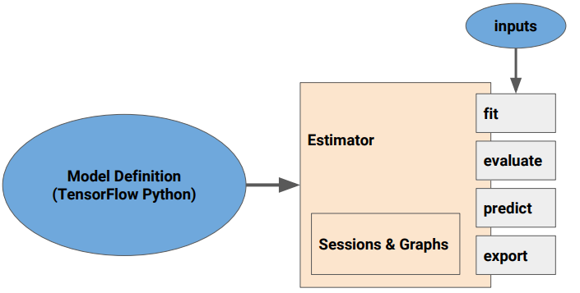
Estimators distributed training loop
build the graph
initialize variables
load data
handle exceptions
create checkpoint files and recover from failures
save summaries for TensorBoard

Slide 39
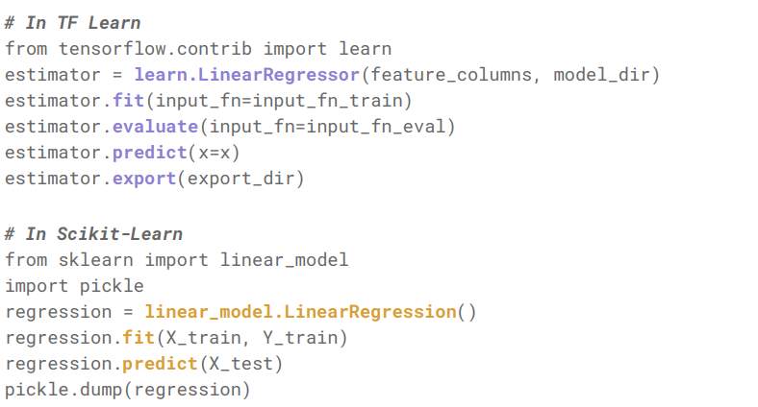
Estimators Modeled After Scikit-Learn Interface

Slide 40
Executing graphs across compute devices
A graph can be divided into multiple parts and each part can be placed and executed on separate devices, such as a CPU or GPU. You can list all the devices available for graph execution with the following command:
from tensorflow.python.client import device_lib
print(device_lib.list_local_devices())

Slide 41
TensorBoard
TensorFlow includes functions to debug and optimize programs in a visualization tool called TensorBoard.
Using TensorBoard, you can observe different types of statistics concerning the parameters and details of any part of the graph computing graphically.
You can use TensorBoard to visualize your TensorFlow graph, plot quantitative metrics about the execution of your graph, and show additional data such as images that pass through it.

Slide 42
How Does TensorBoard Work?
The workflow when using TensorBoard is:
Build your computational graph/code
Attach summary ops to the nodes you are interested in examining
Start running your graph as you normally would
Additionally, run the summary ops
When the code is done running, run TensorBoard to visualize the summary outputs

Slide 43
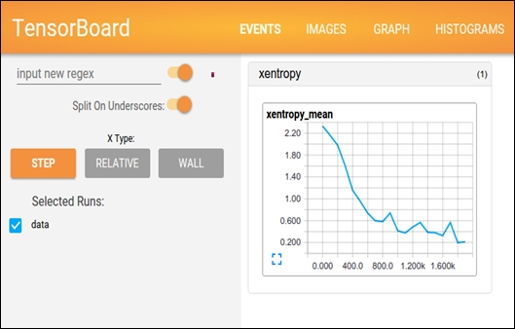
How Does TensorBoard Work?

Slide 44
Machine Learning with TensorFlow
General model:
y=f(x)
Some capabilities
Regression
Simple linear regression
Multi regression
Regularized regression
Lasso regularization
Ridge regularization
ElasticNet regularization
Classification
Classification using logistic regression
Binary classification
Multiclass classification

Slide 45
TensorFlow contains complete algorithms
Linear{Classifier,Regressor}
DNN{Classifier,Regressor}
DNNLinearCombined{Classifier,Regressor}
SVM
KMeansClustering
GMM

Slide 46
Keras : Deep neural network library
Keras is a high-level neural networks API, written in Python and capable of running on top of TensorFlow, CNTK, or Theano. It was developed with a focus on enabling fast experimentation. Being able to go from idea to result with the least possible delay is key to doing good research.
Use Keras if you need a deep learning library that:
Allows for easy and fast prototyping (through user friendliness, modularity, and extensibility).
Supports both convolutional networks and recurrent networks, as well as combinations of the two.
Runs seamlessly on CPU and GPU.
Read the documentation at Keras.io.

Slide 47
Keras workflow
Prepare input data (Image, video, text, column data, ..)
Define the neural network architecture (sequential/functional)
Select the optimizer
Select the loss function
Select the appropriate evaluation metric for the given problem
Train and evaluate

Slide 48
Model type
Sequential:
models are linear stack of layers
Treat each layer as object that feed into the next.
Graph
Optimized over all outputs
Graph model allows for two or more independent networks to diverge or merge
Allows for multiple separate inputs/outputs
Different merging layers

Slide 49
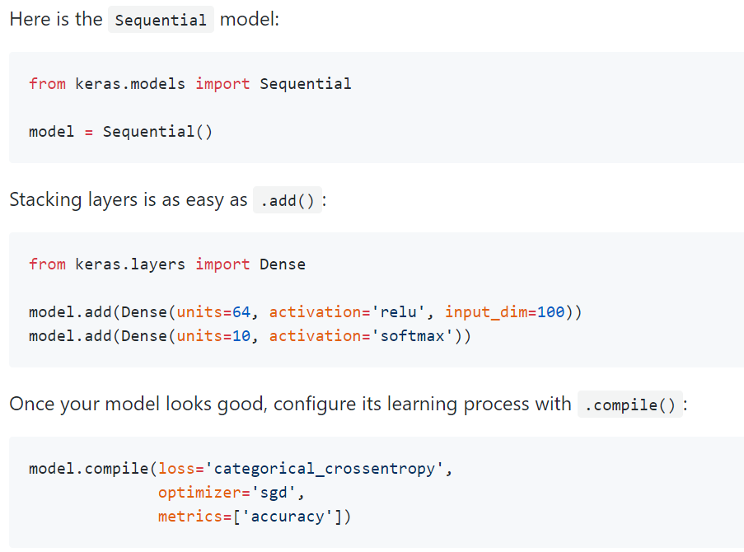
Sequential class

